Slide 1
Ratio of Tans
From a BMO question

Slide 2
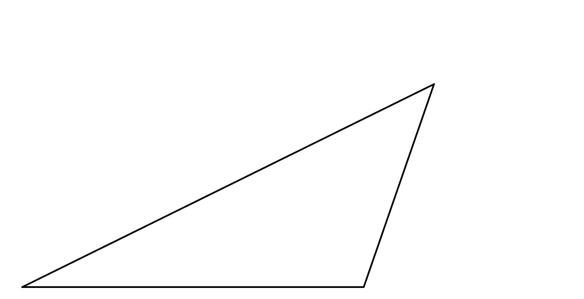




Ratio of Tans
$$C \left(12.7, 7\right)$$
$$\frac{\tan{C}}{\tan{A}}$$
Find the ratio:
$$A$$
$$\left(3.1, 2.2\right)$$
$$B$$
$$\left(11.1, 2.2\right)$$
(not to scale)
Notes:
9.6 4.8

Slide 3

Ratio of Tans
Translate the triangle by vector $\left(\begin{matrix}−3.1 \\ −2.2\end{matrix}\right)$.
$$C \left(12.7, 7\right)$$
$$A$$
$$\left(3.1, 2.2\right)$$
$$B$$
$$\left(11.1, 2.2\right)$$
(not to scale)
Notes:
9.6 4.8

Slide 4



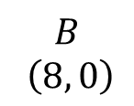
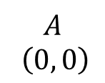
Ratio of Tans
Determine some side lengths.
$$C \left(9.6, 4.8\right)$$
$$\sqrt{25.6}$$
$$A$$
$$\left(0, 0\right)$$
$$8$$
$$B$$
$$\left(8, 0\right)$$
(not to scale)
Notes:
9.6 4.8

Slide 5
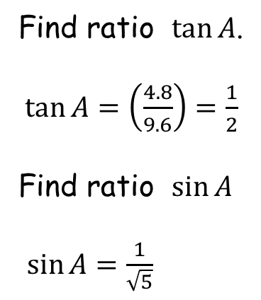
Ratio of Tans
Find ratio $\tan{A}$.
$\tan{A}{=\left(\frac{4.8}{9.6}\right)=\frac{1}{2}}$
Find ratio $\sin{A}$
$\sin{A=\frac{1}{\sqrt{5}}}$
$$C \left(9.6, 4.8\right)$$
$$\sqrt{25.6}$$
$$A$$
$$\left(0, 0\right)$$
$$8$$
$$B$$
$$\left(8, 0\right)$$
(not to scale)
Notes:
9.6 4.8

Slide 6

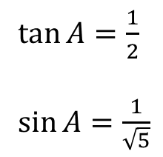
$\tan{A}{=\frac{1}{2}}$
$\sin{A=\frac{1}{\sqrt{5}}}$
Ratio of Tans
Use the Sine Rule to find ratio $\sin{C}$.
$$\frac{\sin{C}}{8}=\frac{\sin{A}}{\sqrt{25.6}}$$
$$\sin{C}=\frac{\left(8×\frac{1}{\sqrt{5}}\right)}{\sqrt{25.6}}=\frac{8}{\sqrt{128}}=\frac{1}{\sqrt{2}}$$
$$C \left(9.6, 4.8\right)$$
$$\sqrt{25.6}$$
$$A$$
$$\left(0, 0\right)$$
$$8$$
$$B$$
$$\left(8, 0\right)$$
(not to scale)
Notes:
9.6 4.8

Slide 7

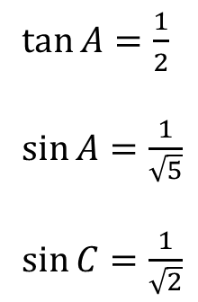
$\tan{A}{=\frac{1}{2}}$
$\sin{A=\frac{1}{\sqrt{5}}}$
$\sin{C=\frac{1}{\sqrt{2}}}$
Ratio of Tans
Find the ratio $\tan{C}$.
$\sin{C}=\frac{1}{\sqrt{2}}$ so $\tan{C}=\frac{1}{1}=1$
Finally,
$$\frac{\tan{C}}{\tan{A}}=\frac{1}{\left(\frac{1}{2}\right)}=2$$
$$C \left(9.6, 4.8\right)$$
$$\sqrt{25.6}$$
$$A$$
$$\left(0, 0\right)$$
$$8$$
$$B$$
$$\left(8, 0\right)$$
(not to scale)
Notes:
9.6 4.8

Slide 8

Ratio of Tans
How is $\frac{\tan{C}}{\tan{A}}=2$ for all of the worksheets?
$$C \left(9.6, 4.8\right)$$
$$\sqrt{25.6}$$
$$A$$
$$\left(0, 0\right)$$
$$8$$
$$B$$
$$\left(8, 0\right)$$
(not to scale)
Notes:
9.6 4.8

Slide 9
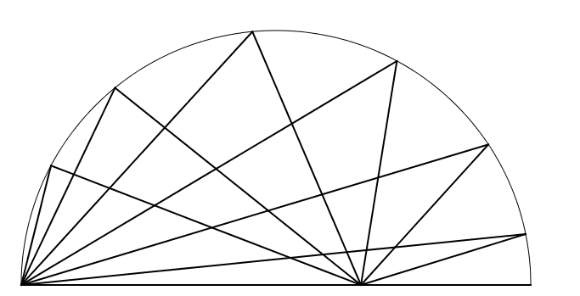
Ratio of Tans
Hint: All triangles fit in the same semicircle.

Slide 10
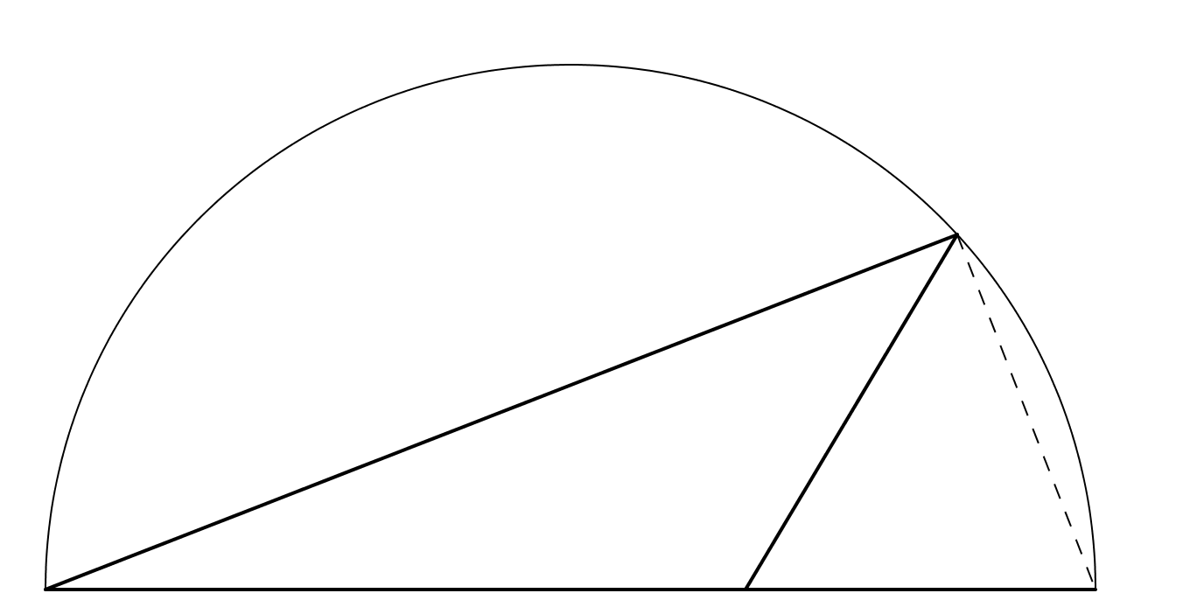
Ratio of Tans
Angle in a semicircle is a right angle.

Slide 11
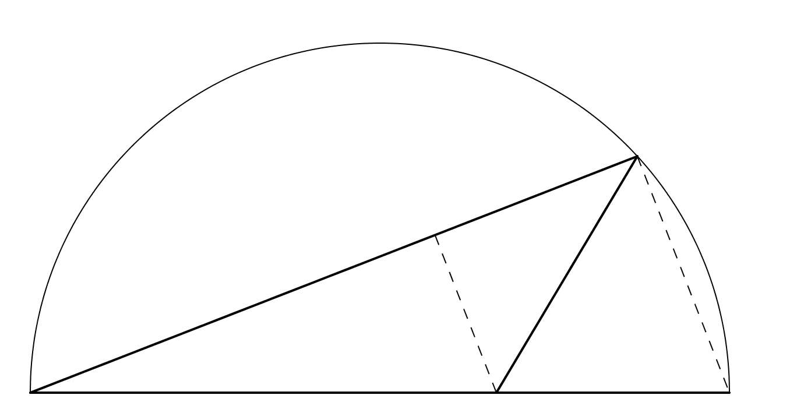
Ratio of Tans
Hint: The two dashed lines are parallel.

Slide 12
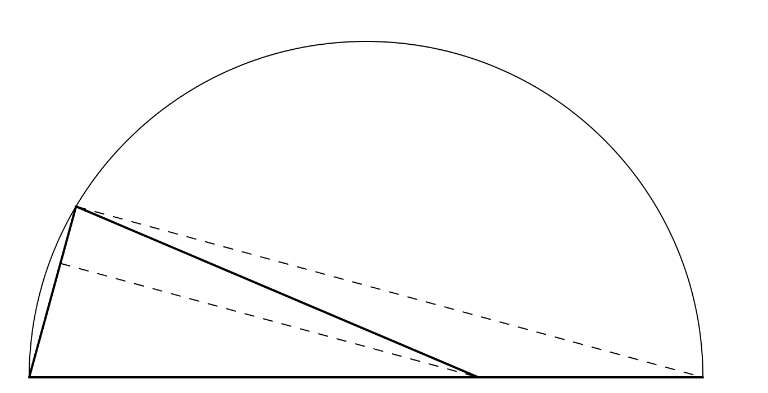
Ratio of Tans
And they always are, whatever the triangle.

Slide 13
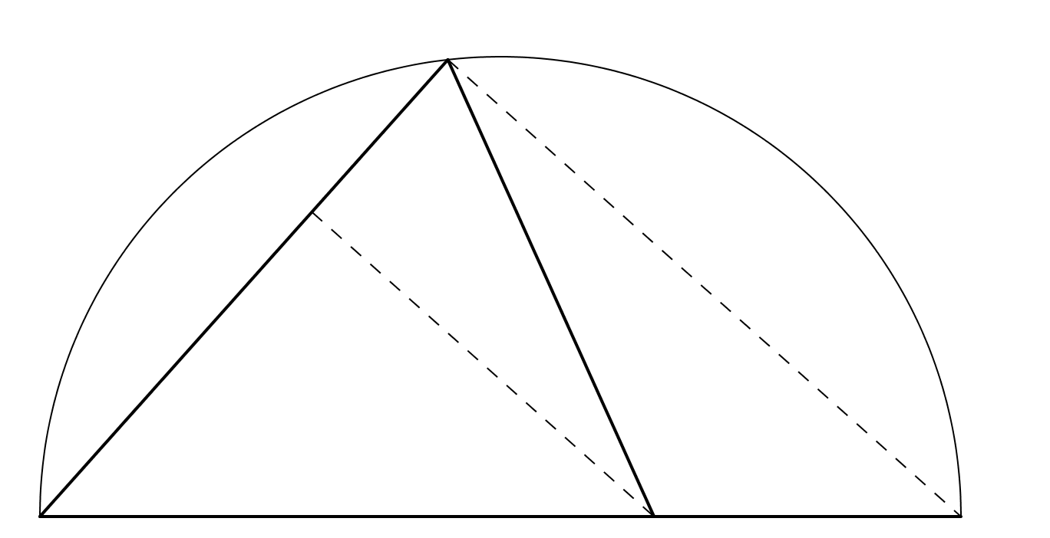
Ratio of Tans
And they always are, whatever the triangle.

Slide 14
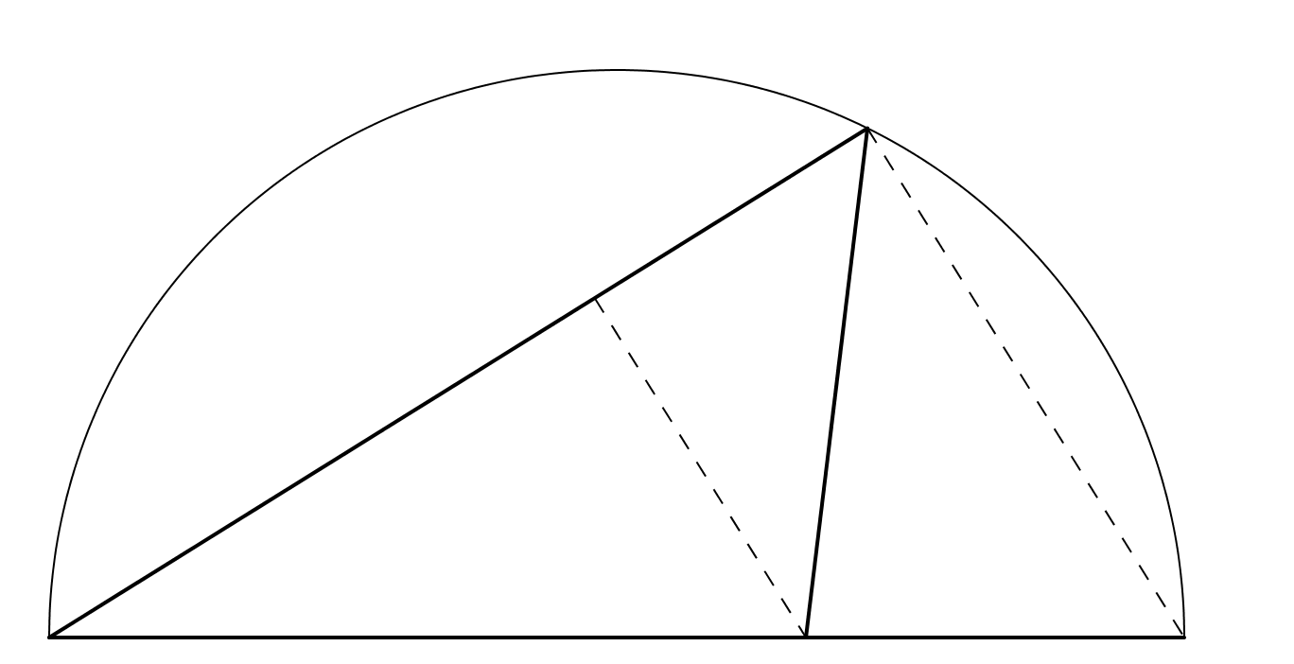
Ratio of Tans
And they always are, whatever the triangle.

Slide 15
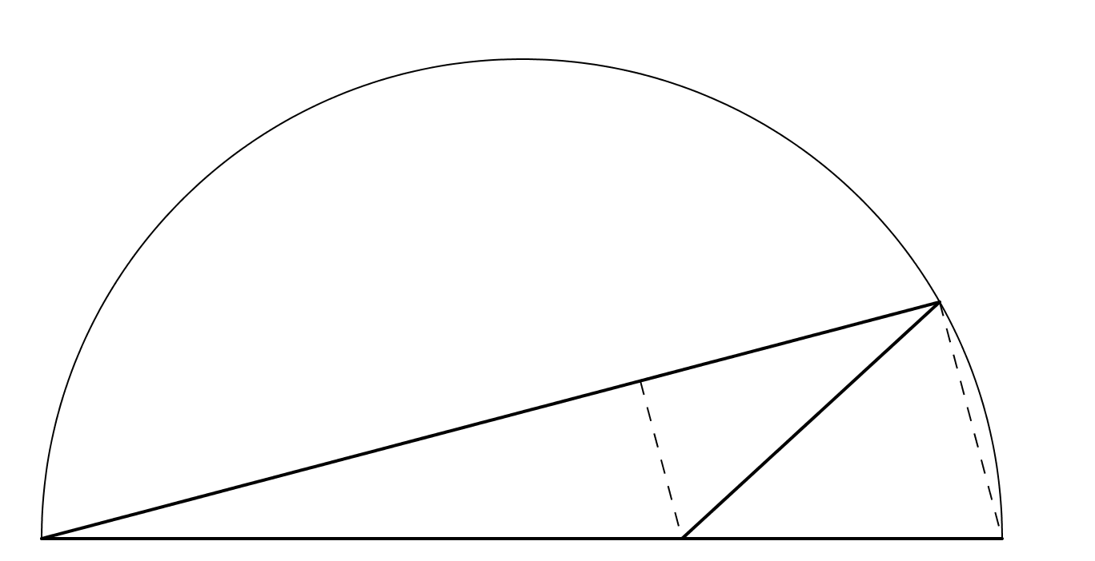
Ratio of Tans
And they always are, whatever the triangle.

Slide 16




Ratio of Tans
$$C$$
$$A$$
$$B$$
$$D$$

Slide 17

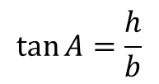

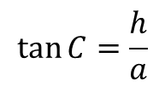



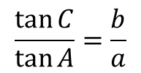
Ratio of Tans
$$\tan{C=\frac{h}{a}}$$
$$\tan{A=\frac{h}{b}}$$
$$\frac{\tan{C}}{\tan{A}}=\frac{b}{a}$$
$$C$$
$$a$$
$$b$$
$$h$$
$$A$$
$$d$$
$$B$$
$$c$$
$$D$$

Slide 18

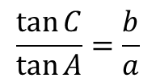
Ratio of Tans
$$\frac{d}{b}=\frac{c+d}{a+b}$$
$$ad+bd=bc+bd$$
$$ad=bc$$
$$\frac{d}{c}=\frac{b}{a}$$
$$\frac{\tan{C}}{\tan{A}}=\frac{b}{a}$$
$$C$$
$$a$$
$$b$$
$$h$$
$$A$$
$$d$$
$$B$$
$$c$$
$$D$$

Slide 19

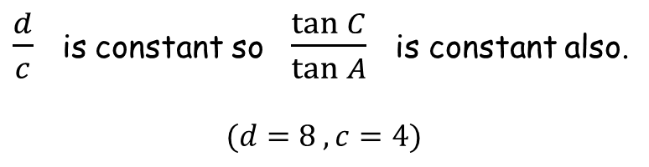
Ratio of Tans
$$\frac{\tan{C}}{\tan{A}}=\frac{b}{a}$$
$\frac{d}{c}$ is constant so $\frac{\tan{C}}{\tan{A}}$ is constant also.
$$(d=8 , c=4)$$
$$\frac{d}{c}=\frac{b}{a}$$
$$C$$
$$a$$
$$b$$
$$h$$
$$A$$
$$d$$
$$B$$
$$c$$
$$D$$

Slide 21
RESOURCES

Slide 22
Ratio of Tans
SIC_54
$$C \left(12.7, 7\right)$$
$$\frac{\tan{C}}{\tan{A}}$$
Find the ratio:
$$A$$
$$\left(3.1, 2.2\right)$$
$$B$$
$$\left(11.1, 2.2\right)$$
(not to scale)
Notes:
9.6 4.8

Slide 23
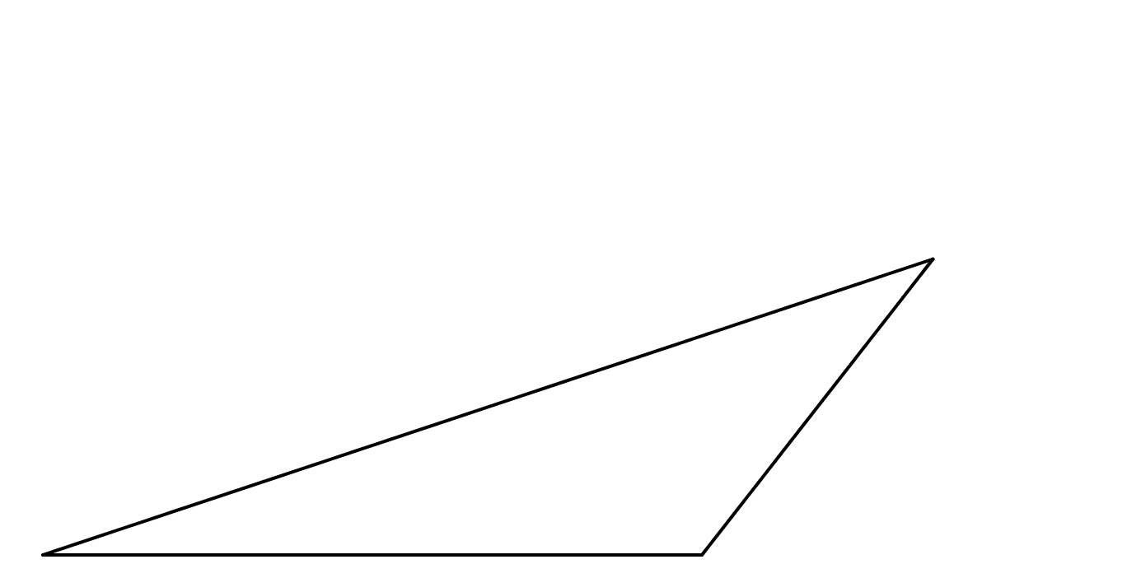

Ratio of Tans
SIC_54
$$\frac{\tan{C}}{\tan{A}}$$
Find the ratio:
$$\left(13.9, 5.8\right)$$
$$C$$
$$A$$
$$\left(3.1, 2.2\right)$$
$$B$$
$$\left(11.1, 2.2\right)$$
(not to scale)
Notes:
10.8 3.6

Slide 24
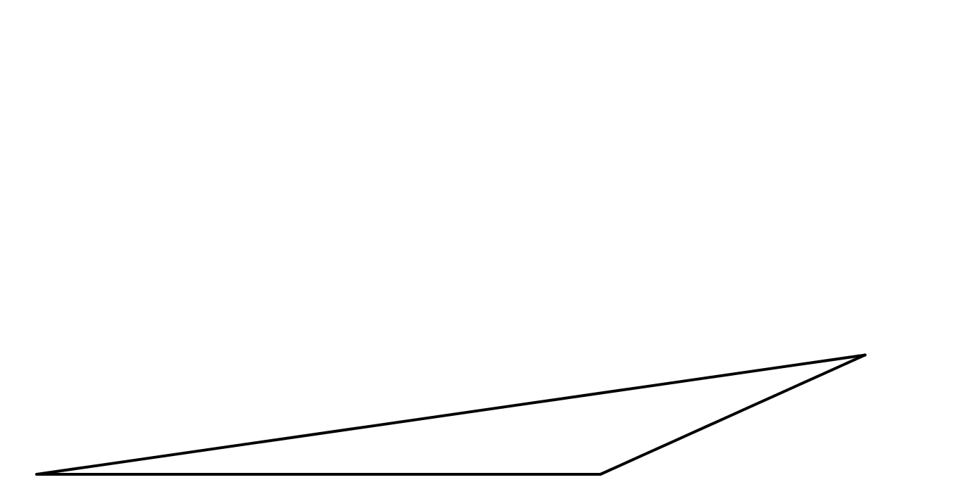


Ratio of Tans
SIC_54
$$\frac{\tan{C}}{\tan{A}}$$
Find the ratio:
$$\left(14.86, 3.88\right)$$
$$C$$
$$A$$
$$\left(3.1, 2.2\right)$$
$$B$$
$$\left(11.1, 2.2\right)$$
(not to scale)
Notes:
11.76 1.68

Slide 25
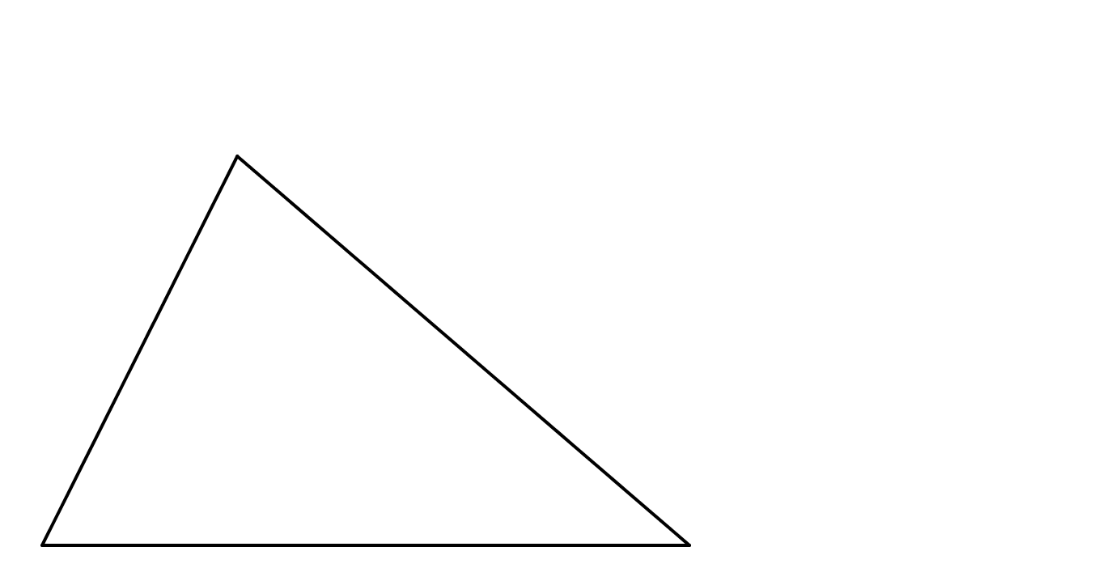


Ratio of Tans
SIC_54
$$\left(5.5, 7\right)$$
$$C$$
$$\frac{\tan{C}}{\tan{A}}$$
Find the ratio:
$$A$$
$$\left(3.1, 2.2\right)$$
$$B$$
$$\left(11.1, 2.2\right)$$
(not to scale)
Notes:
2.4 4.8

Slide 26
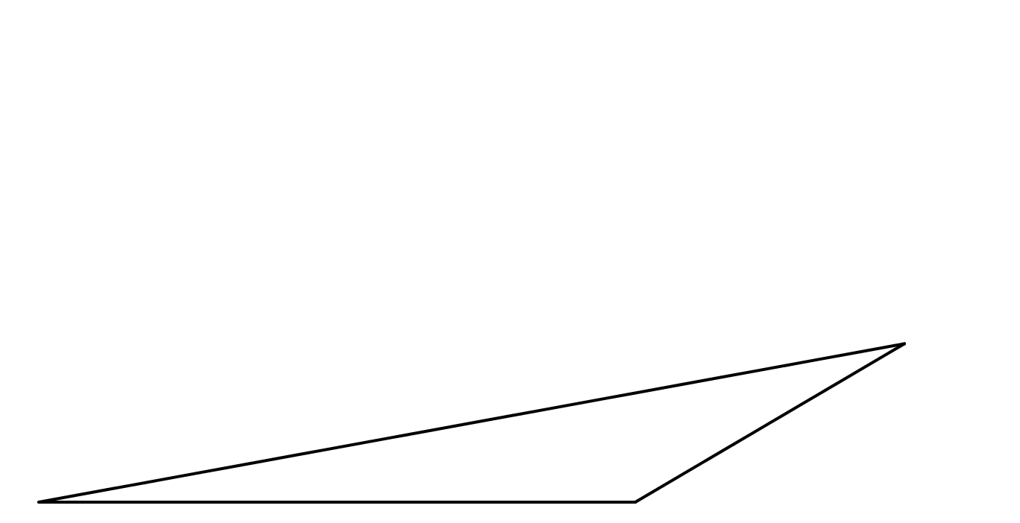

Ratio of Tans
SIC_54
$$\frac{\tan{C}}{\tan{A}}$$
Find the ratio:
$$\left(14.176, 4.312\right)$$
$$C$$
$$A$$
$$\left(3.1, 2.2\right)$$
$$B$$
$$\left(11.1, 2.2\right)$$
(not to scale)
Notes:
11.616 2.112

Slide 27
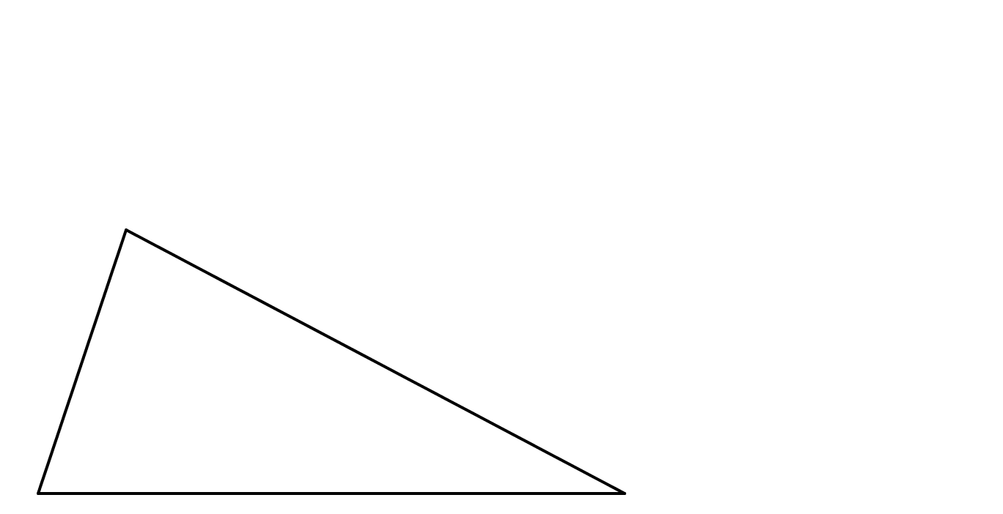

Ratio of Tans
SIC_54
$$\left(4.3, 5.8\right)$$
$$C$$
$$\frac{\tan{C}}{\tan{A}}$$
Find the ratio:
$$A$$
$$\left(3.1, 2.2\right)$$
$$B$$
$$\left(11.1, 2.2\right)$$
(not to scale)
Notes:
1.2 3.6

Slide 28
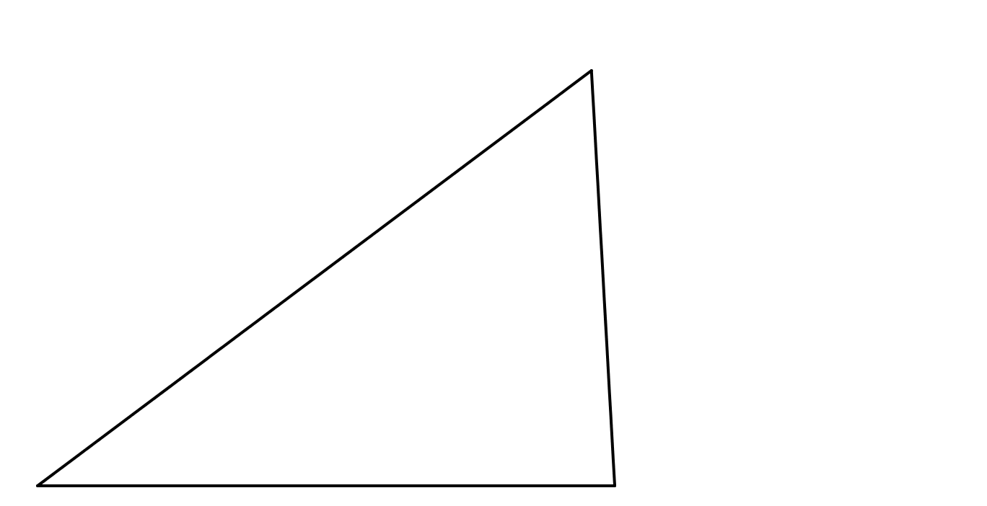


Ratio of Tans
SIC_54
$$\left(10.78, 7.96\right)$$
$$C$$
$$\frac{\tan{C}}{\tan{A}}$$
Find the ratio:
$$A$$
$$\left(3.1, 2.2\right)$$
$$B$$
$$\left(11.1, 2.2\right)$$
(not to scale)
Notes:
7.68 5.76

Slide 29
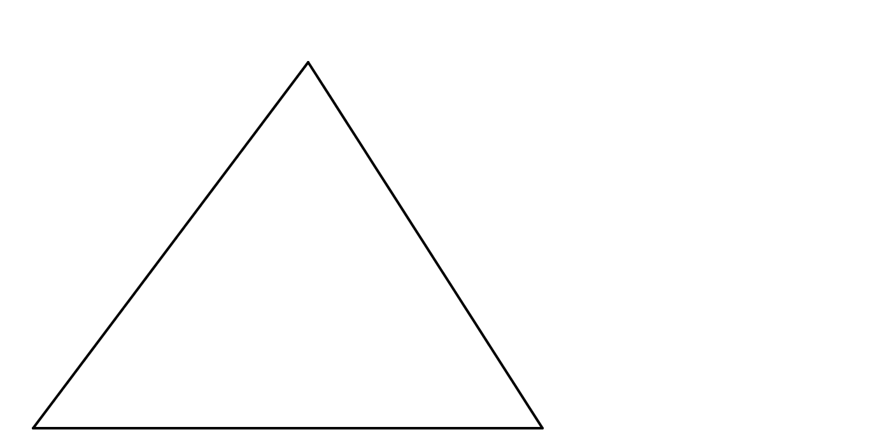

Ratio of Tans
SIC_54
$$\left(7.42, 7.96\right)$$
$$C$$
$$\frac{\tan{C}}{\tan{A}}$$
Find the ratio:
$$A$$
$$\left(3.1, 2.2\right)$$
$$B$$
$$\left(11.1, 2.2\right)$$
(not to scale)
Notes:
4.32 5.76

Slide 30
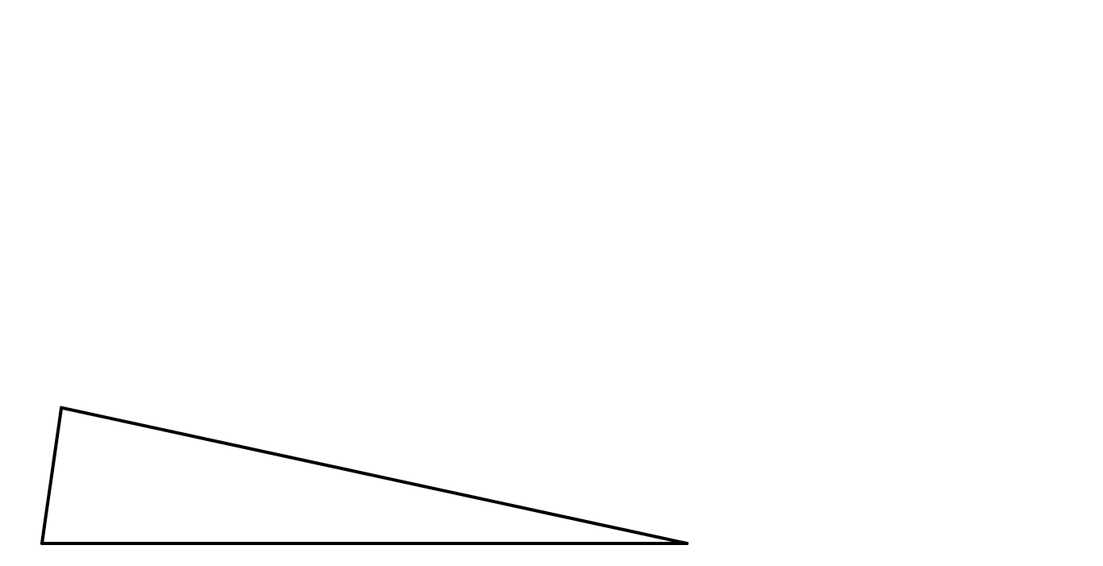


Ratio of Tans
SIC_54
$$\frac{\tan{C}}{\tan{A}}$$
Find the ratio:
$$\left(3.34, 3.88\right)$$
$$C$$
$$A$$
$$\left(3.1, 2.2\right)$$
$$B$$
$$\left(11.1, 2.2\right)$$
(not to scale)
Notes:
0.24 1.68

Slide 31
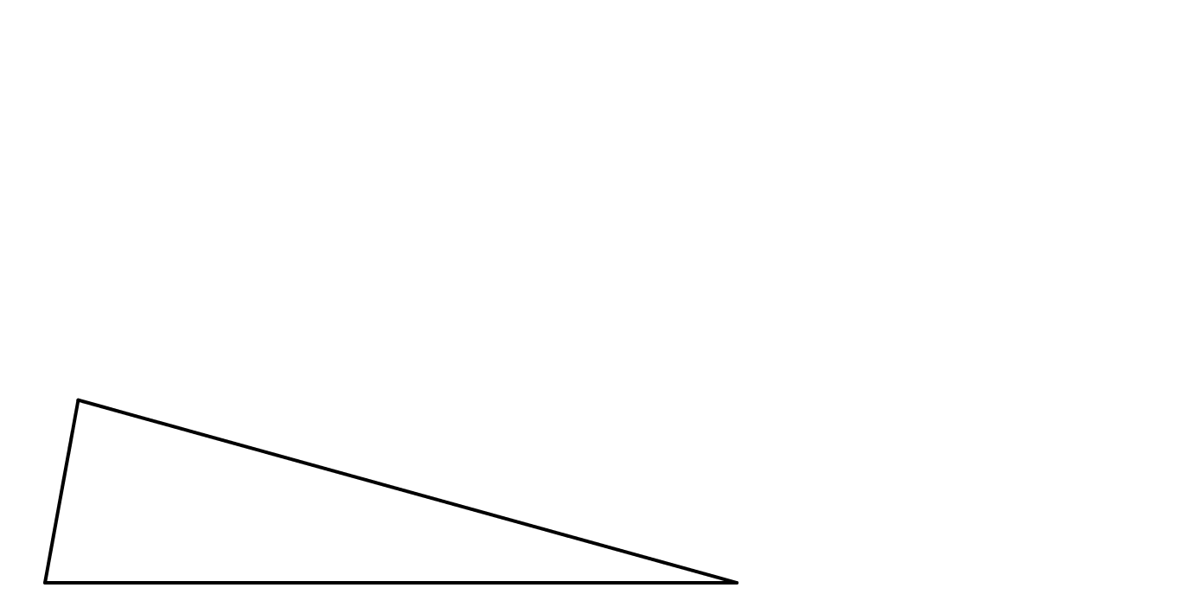

Ratio of Tans
SIC_54
$$\frac{\tan{C}}{\tan{A}}$$
$$\left(3.484, 4.312\right)$$
$$C$$
Find the ratio:
$$A$$
$$\left(3.1, 2.2\right)$$
$$B$$
$$\left(11.1, 2.2\right)$$
(not to scale)
Notes:
0.384 2.112

Slide 32
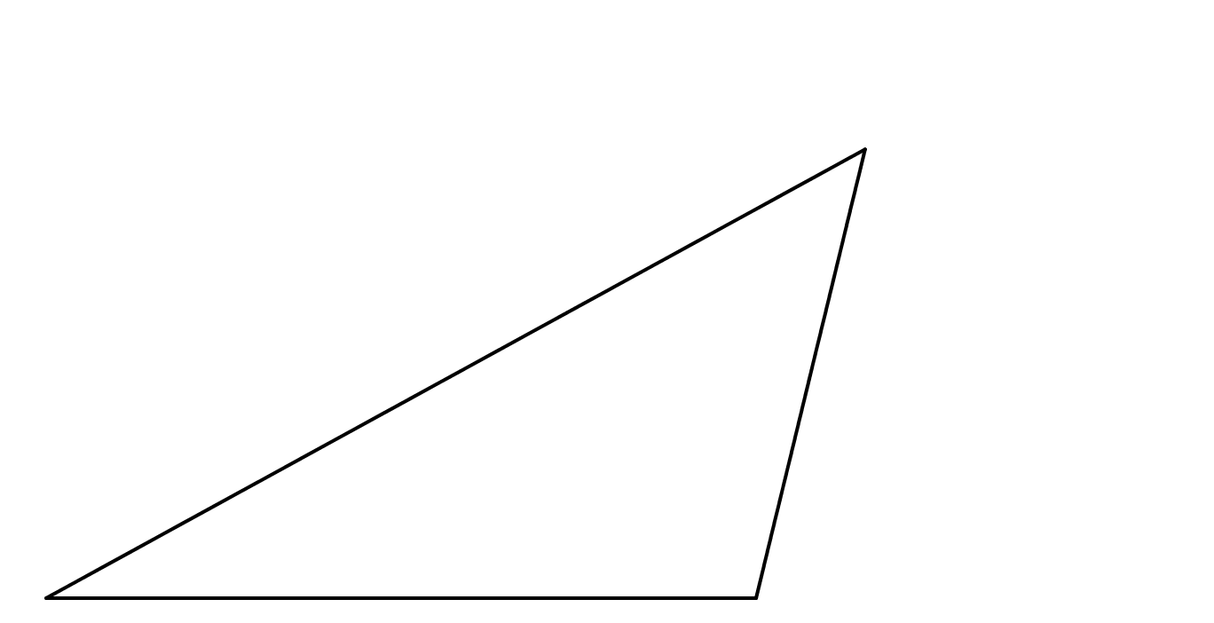
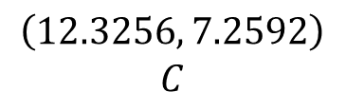
Ratio of Tans
SIC_54
$$\frac{\tan{C}}{\tan{A}}$$
$$\left(12.3256, 7.2592\right)$$
$$C$$
Find the ratio:
$$A$$
$$\left(3.1, 2.2\right)$$
$$B$$
$$\left(11.1, 2.2\right)$$
(not to scale)
Notes:
9.2256 5.0592

Slide 33
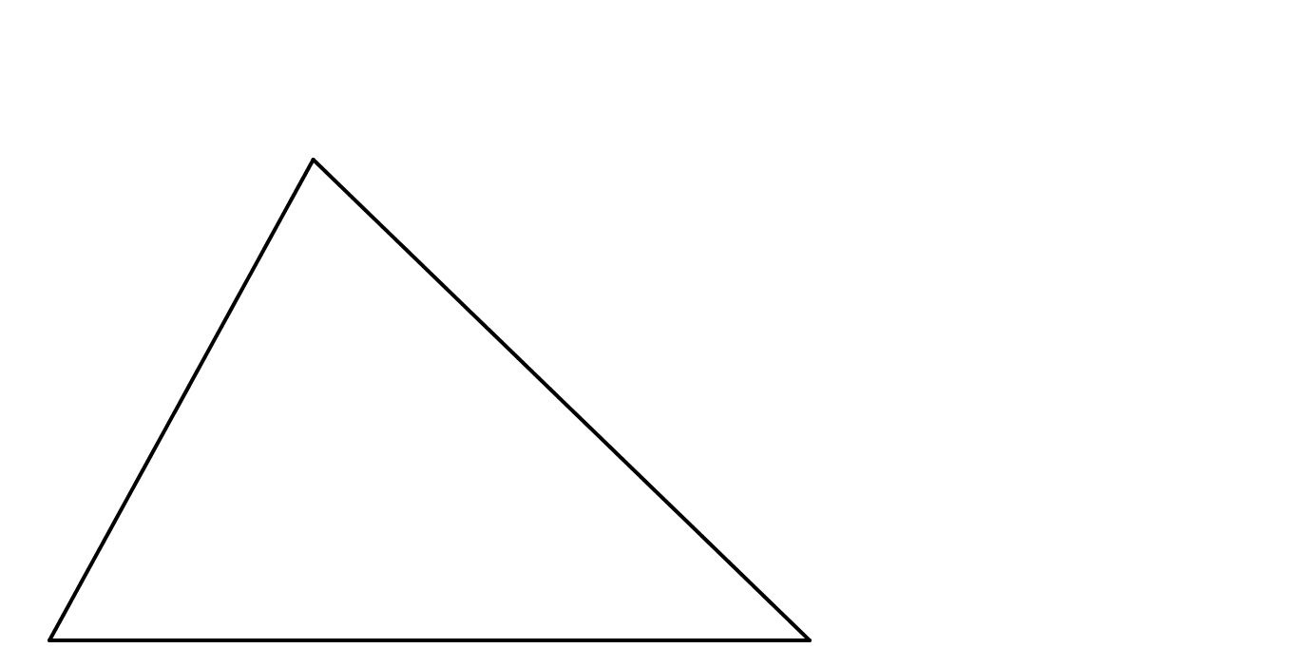

Ratio of Tans
SIC_54
$$\left(5.8744, 7.2592\right)$$
$$C$$
$$\frac{\tan{C}}{\tan{A}}$$
Find the ratio:
$$A$$
$$\left(3.1, 2.2\right)$$
$$B$$
$$\left(11.1, 2.2\right)$$
(not to scale)
Notes:
2.7744 5.0592

